Slide 1


Aileadtech Data Science Conference
Kehinde Ajayi

Slide 2
Agenda
James Obidiegwu – A brief talk on his background, and tips on how he excels in his Masters program.
Kehinde Ajayi – About Aileadtech
Ahmed Lawal – Tips to become successful in Data Science (Academic and Industry)
Damilola Popoola - A brief talk on her background, and tips on how she excels in his Masters program
John Atughara - A brief talk on his background, and tips on how he excels in his Masters program
Question and Answer

Slide 3
About Aileadtech
A tech company whose vision is to position Africa as a leading player in the learning, research, and deployment of Artificial Intelligence (AI) to everyday life.
We train students, graduates, and professionals interested in the field and sub-field of AI.
We have trained students across Nigeria, UK, USA, Cameroon, and Turkey.

Slide 4
Our Mission
To improve the educational system of Africa by inculcating computing skills in the system.
To train students, graduates and professionals interested in the field and sub-field of Artificial Intelligence (AI).
To raise over 10 million Africans with sound knowledge and expertise in the field of AI.
To develop the youths and enhance the creation of jobs and opportunities through AI.
To greatly increase the percentage of Africans in the tech industry.

Slide 5
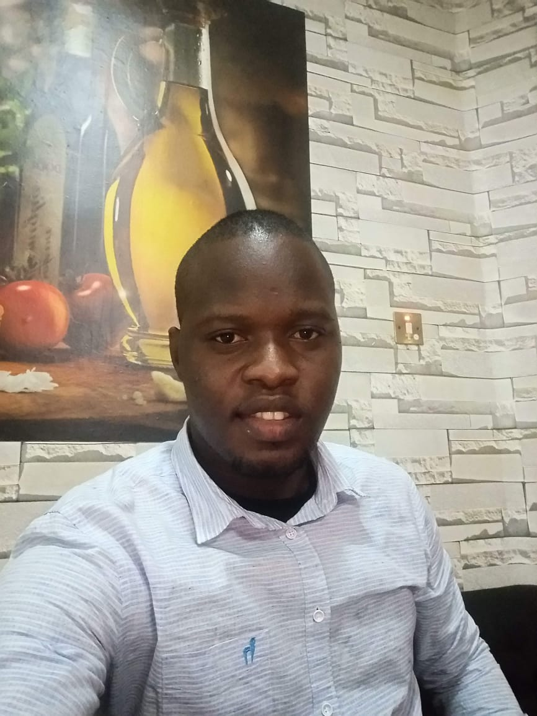
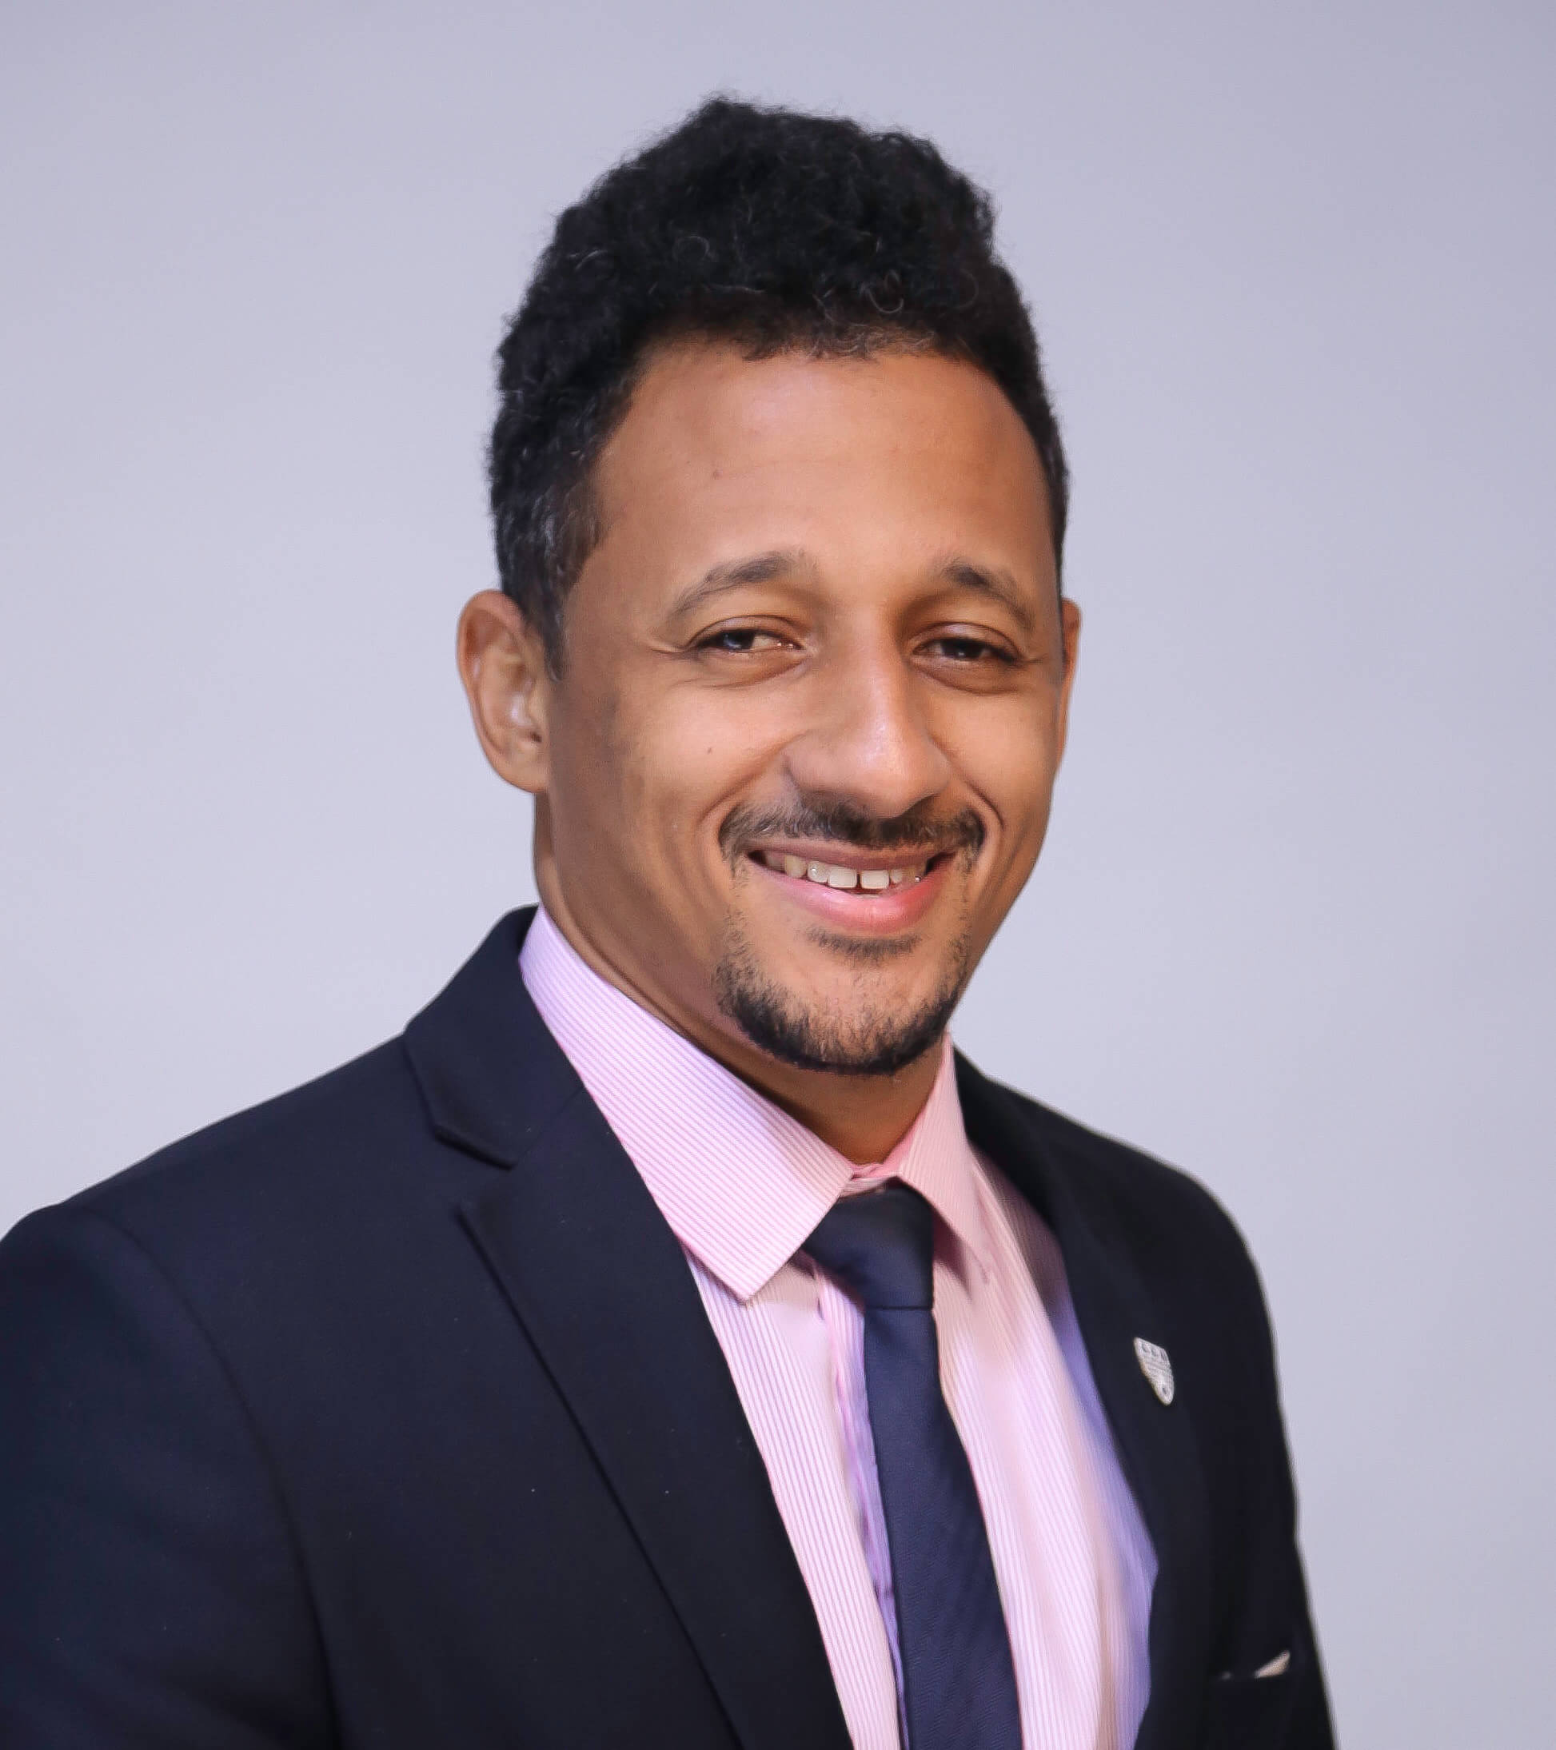
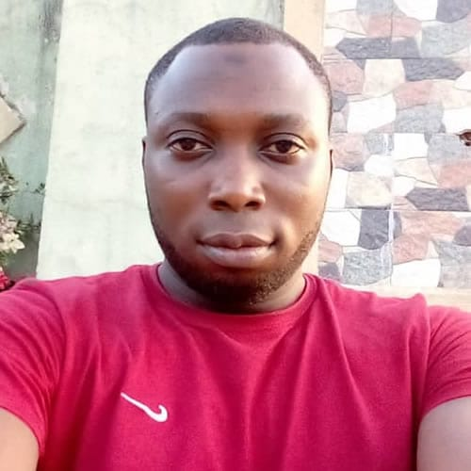
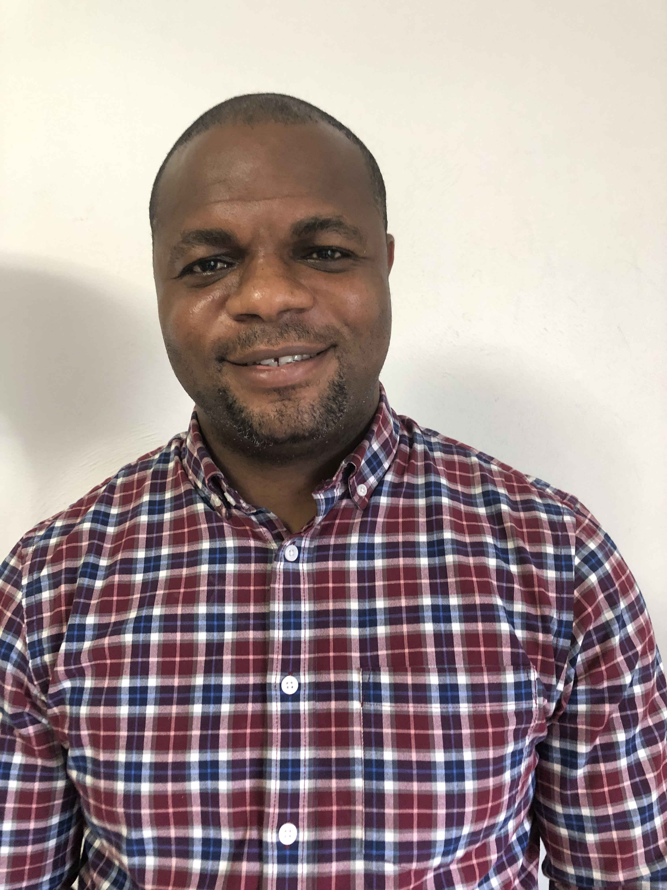
Our Core team
Dr. Francis Okoye
Senior Data Analyst
Opeyemi Wasiu
Software Developer
Damilola Adebambi
Business Manager
Kehinde Ajayi
Lead Data Scientist

Slide 6
Courses we offer
Fundamentals of Data Science and AI.
Machine Learning Specialization.
Deep Learning Specialization.
Machine Learning Engineering with Microsoft Azure.
Data Analytics with Excel, SQL, Python, and PowerBI.
Frontend Web Development.
Backend Web Development.
Full Stack Development.

